Slide 1
Evolving IRs to serve our expanding open scholarship priorities
Sadie Roosa
Amy Nurnberger
Futuristic Information Systems: Aspirations and Apprehensions
C H Mohammed Koya Library, University of Calicut
2022-08-25
This work is licensed under a Creative Commons Attribution 4.0 International License.

Slide 2
Introduction & Expectations
Sadie Roosa,
Collections Strategist for Repository Services
Interim Collections Strategist for Sustainability
Amy Nurnberger
Program Head, Data Management Services
Interim Department Head, Data and Specialized Services
Today we will cover:
Background of MIT’s institutional repository
Evolution of philosophy, collections, and technology
Areas of investment
Current and future developments

Slide 3
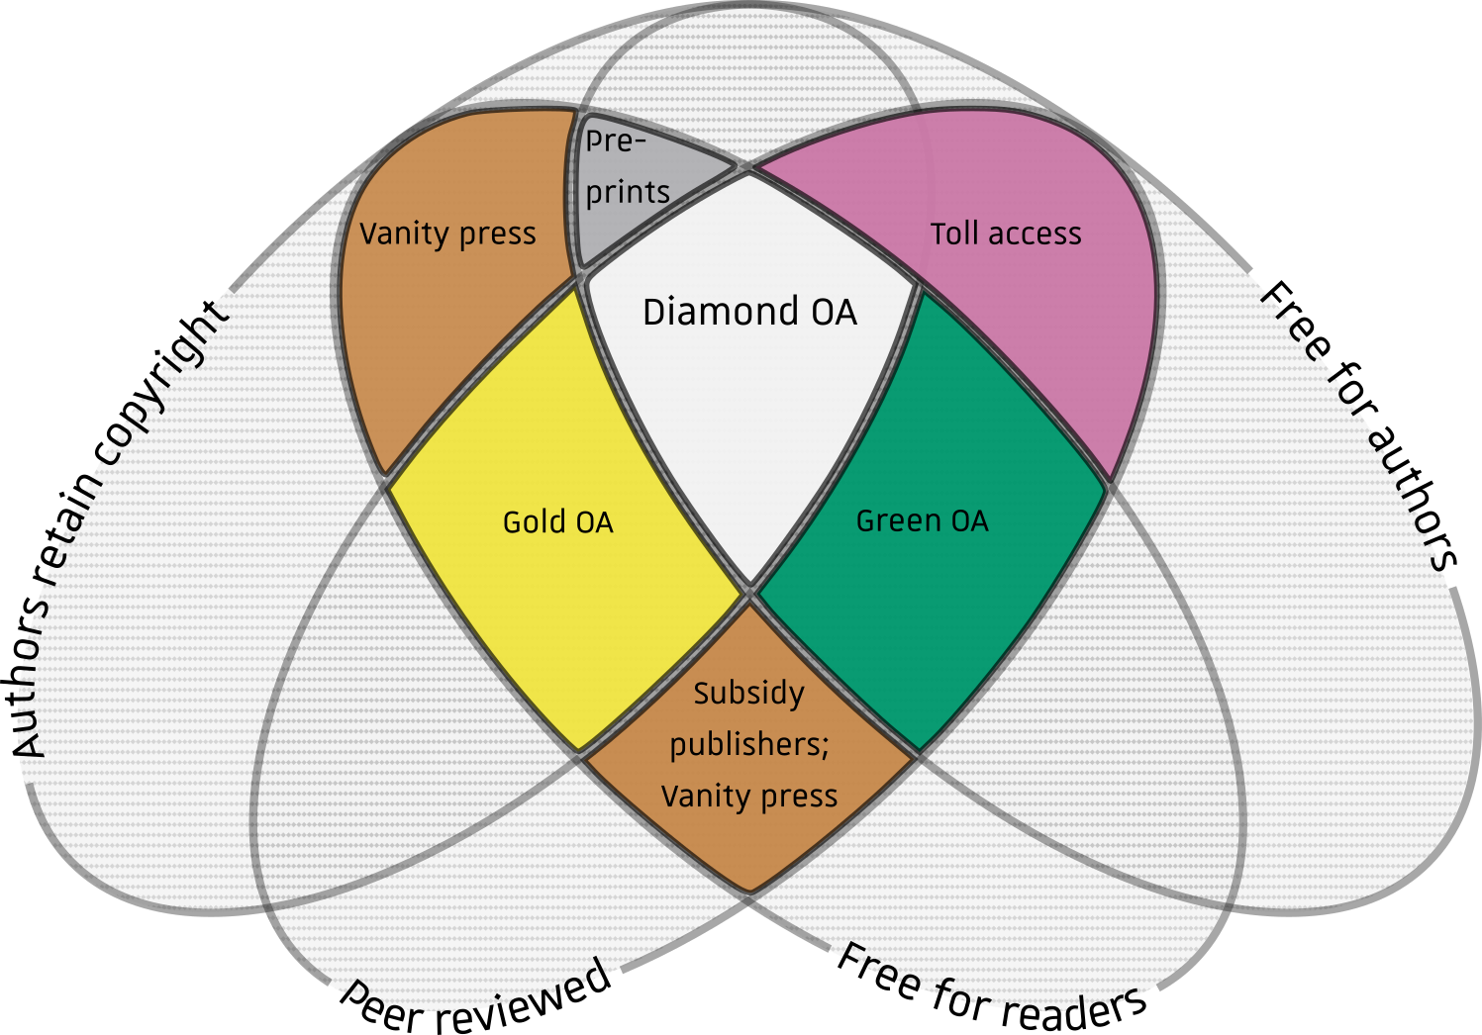
Framing within OA movement: colours
“Open Access colours Venn” Adapted from Farquharson, Jamie Ian (2018-07-31). "Introducing Volcanica: The first diamond open-access journal for volcanology". Volcanica 1 (1): i–ix. DOI:10.30909/vol.01.01.i-ix. ISSN 2610-3540. Jamie Farquharson, CC BY 4.0, via Wikimedia Commons https://commons.wikimedia.org/wiki/File:Open_Access_colours_Venn.png
Notes:
Budapest
Gold and Green and Platinum/diamond
Faculty OA statement – 2009

Slide 4
Abbreviated History of OA & MIT Institutional Repository
Hind Swaraj (eng) published, “No Rights Reserved”*
Symplectic Elements integration
Budapest OA Initiative
DSpace Federation
DSpace Foundation
OSTP (US) OA-ish policy
H2020 (EU)
MIT & HP launch DSpace
IQSS metadata exchange
MIT faculty OA policy
ICAR (IN) OA policy
MIT Collections budget shift
ETD requirement
arXiv.org
1910
1991
2002
2004
2005
2007
2009
2013
2016
2017
2021
* "Would Gandhi have been a Wikipedian?". The Indian Express. 17 January 2012. Archived from the original on 9 December 2012.
Notes:
Hidden slide with all of the timeline components still as separate entities that can be moved, deleted, or edited. Non-hidden version of this slide includes a screenshot of the image with alt text describing it as a whole. If the timeline needs to be changed, change it hear and replace the screenshot and alt text on the other slide.

Slide 5
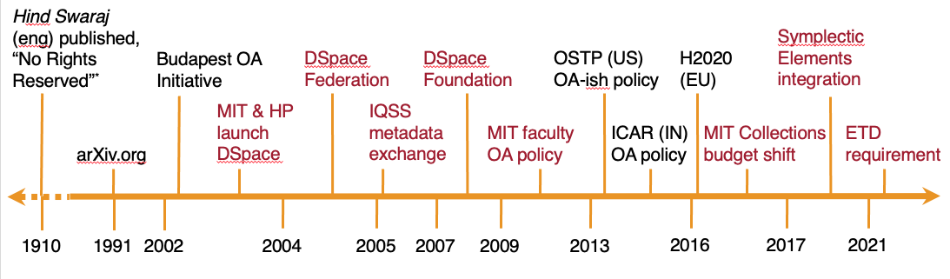
Abbreviated History of OA & MIT Institutional Repository
* "Would Gandhi have been a Wikipedian?". The Indian Express. 17 January 2012. Archived from the original on 9 December 2012.
Notes:
says MacKenzie Smith, the associate director for technology at
MIT Libraries. "The faculty members are keeping their research under their desks, on lots and lots of disks, and praying that nothing happens to it.
We have a long way to go." Tech Review article from https://www.hts.stevenwood.com/ics3u/cos/units/1/activity14/fading_memory.pdf July2005
2002 – Dspace launch in collab w HP
2004 – Dspace Federation
2005 – PLEDGE project for metadata exchange b/t IQSS DVN and Dspace McNeill, Katherine. "Interoperability Between Institutional and
Data Repositories: a Pilot Project at MIT." IASSIST Quarterly, Fall &
Winter (2007) https://dspace.mit.edu/bitstream/handle/1721.1/66981/Mcneill2007-Interoperability.pdf?sequence=2&isAllowed=y http://hdl.handle.net/1721.1/66981
2007 – Dspace Foundation
2016 – Shift of MIT collections budget Finnie, Ellen and Arthur, Michael A. (2016) "Being Earnest With Collections--Voting with our Dollars: Making a New Home for the
Collections Budget in the MIT Libraries," Against the Grain: Vol. 28: Iss. 4, Article 52.
DOI: https://doi.org/10.7771/2380-176X.7496

Slide 6
Evolution of open philosophy
Open data
Rights & reuse
Repository strategy
Research Data Index
DOI Service
Framework for Publisher Contracts
Sustainable infrastructure
Open code
Open & Equitable Scholarship
Open Access
Open Scholarship
Computational access
Incentives
MIT Faculty OA policy
Equitable contributions
Notes:
Hidden slide with all of the diagram components still as separate entities that can be moved, deleted, or edited. Non-hidden version of this slide includes a screenshot of the image with alt text describing it as a whole. If the diagram needs to be changed, change it hear and replace the screenshot and alt text on the other slide.

Slide 7
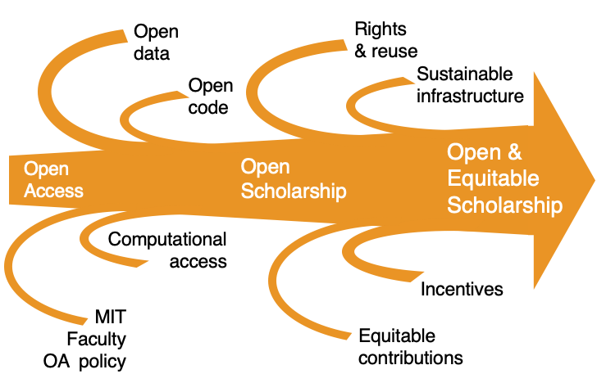
Evolution of open philosophy
Repository strategy
Research Data Index
DOI Service
Framework for Publisher Contracts

Slide 8
Evolution of open philosophy
Repository strategy
Research Data Index
DOI Service
Framework for Publisher Contracts

Slide 9
MIT Framework for Publisher Contracts
Core Principles
Computational access
Long-term digital preservation and access
Transparent cost-based pricing for value-added services
No waivers
Rights retention/generous reuse rights
Autodeposit
https://libraries.mit.edu/scholarly/publishing/framework/
Notes:
So I want to highlight the MIT Framework for Publisher Contracts specifically because it ties pretty closely into how MIT uses our institutional repository to meet our open scholarship goals. We are also doing work outside of the repository, but we don’t have the time to cover all of that in this presentation. The Framework was released in 2019 and highlights 6 main areas that we want to see progress on in our agreements with publishers, and since it’s release it has been endorsed by Over 100 other organizations. It is used by the MIT Libraries Negotiations Team, a team comprised of collections, acquisitions, scholarly communications, and copyright librarians who work directly with publishers to push for contract terms that we think will make open access publishing stronger and more equitable. The principles in this framework and the contracts that have been negotiated under it are some of the most concrete examples of how MIT Libraries envisions getting to more open and equitable scholarship.

Slide 10
Evolution of repository technology
A cautionary tale:
Started and have stayed on DSpace so far
Branched off in version 1.8, lots of customizations
  Maintenance challenges
  Unable to contribute back to open source core code
Eventual migration back to core code (6.3)
https://dspace.mit.edu/
Notes:
So the Framework encapsulates some of the values we’re working towards in the future. But before we get too deep into that, let me give you a short summary of specifically where MIT’s institutional repository, DSpace@MIT, has been up to now. We started the repository on DSpace software, and it’s been DSpace the whole time. At DSpace version 1.8, MIT Libraries a lot of customizations and had branched significantly off from the core open source code. After years of going it alone, we ended up with a lot of technical debt, maintenance challenges, and also some really specialized customizations that no other DSpace instances could take advantage of because we were so far away from the core code that there was no way for us to contribute them back to the community. Eventually in 2019, we undertook a huge project to migrate back to core code at version 6.3. Since then the customizations have been relatively minor, keeping us strongly inline with the community. We think open source infrastructure is an important part of open and equitable scholarship, and are happy to be back in a place where we can both take advantage of the work of the community and contribute back to it.

Slide 11
Evolution of repository collections
Overall purpose: Opening MIT content to the world
In the beginning it was mostly working papers, research briefs, and technical reports
Theses also started being added in 2004
More and more DLC collections
OA Articles collection started in 2009
Tried a “if you build it, they will come” approach that did not work
Grey literature digitized from archives
Collection of smaller datasets, related to articles or theses
Notes:
Since we first started the repository, it has always existed to share MIT’s research outputs with the world. At the very beginning it was a centralized place for MIT researchers to share their working papers, reports, and briefs globally in a free and digital format. In 2004, theses were added, and over the years more and more departments, labs, centers, and individual researchers used DSpace collections as a place to share their work. In 2009 we started a Open Access Articles collection to support the implementation of the Open Access policy. Because the repository is not just OA articles and theses, we’ve spent time over the years trying out ways to increase the content in the repository, including digitizing older tech reports and other grey literature and building collections for all departments whether they specifically requested one or not, hoping if they were there folks would start to deposit into them. Over the years, we’ve tried to keep up with the type of research our community is producing, either by providing options to share it through DSpace or recognizing when DSpace isn’t the best place for it and the Libraries needs other services to support those areas.

Slide 12
Areas of investment
Notes:
Now I’d like to address what we’ve valued and therefore invested in over the years. For a very long time, MIT libraries has invested in openness. As much as our collections and our technical systems are important and do require resources, it is the labor of our staff that makes our open scholarship efforts succeed.

Slide 13
Green OA at MIT
Over 47,000 articles, proceedings, and book chapters in the Open Access collection
57% of all MIT authored articles since 2009 is freely available to download in our repository
Nearly 20 million page views
Nearly 21.5 million downloads
Notes:
And one of the areas we’ve invested in staff to work on most is Green OA. I’m going to use our work in Green OA as an example to walk through all of the people and work that go into making an open scholarship effort succeed. By investing in staff to carry out Green OA work, we’ve achieved a really high percentage of MIT articles made freely available, 57% since 2009. Over the years, items from this collection have been downloaded over 21 million times. One of the reasons we choose to invest in Green OA is because it is a more equitable model of open access than some of the other models, like APCs. But to be effective, it does need to be prioritized and resourced. So what does investment in something like Green OA look like over the years?

Slide 14
Investing in Green OA – Acquisitions Staff
One dedicated staff member
Gathers files of openly available work or asks faculty for their final manuscripts
Verifies the version being deposited is in compliance with MIT and publisher policies
Deposits files through Symplectic Elements to DSpace crosswalk
Verifies metadata and files for items auto deposited into DSpace by publishers
Notes:
Well to start, we have one staff member who’s work is primarily to acquire content for the collection. This involves finding articles in the appropriate version, working with researchers submitting their own work, depositing files through Symplectic Elements (for which they also maintain documentation), and verifying any items auto deposited in DSpace by publishers.

Slide 15
Investing in Green OA – Metadata Staff
A team of staff members who also have other responsibilities
Manage crosswalks from data sources into repository
Conduct authority work for author and department names
Verify publications and other descriptive information
Respond to user inquiries about metadata details and access to embargoed items
Notes:
Over the years we’ve also investing in varying level of metadata production support for the Open Access Articles collection. Lately we’ve had multiple folks who dedicate a small percentage of their time to this work, some of which include assigning authority headings for MIT authors and departments, verifying bibliographic information, managing crosswalks from the external sources that metadata is pulled, and responding to user requests about metadata inaccuracies or gaps.

Slide 16
Investing in Green OA – Outreach
The repository and open access teams collaborate with the scholarly communications librarian, liaison librarians and Data Management Services team, who
Understand OA practices and trends in various disciplines
Work with acquisitions staff to maintain relations with faculty and routinely and unobtrusively obtain final manuscripts
Highlight opportunities outside of journal and conference publications for faculty to share research outputs through the repository
Notes:
A successful Green OA effort also requires a lot of outreach work. We have a scholarly communications librarian, many liaison libraries, and a data management services team, all of whom weave supporting the Green OA initiative into their daily work. They serve both as subject matter experts for OA practices in their specific disciplines, as well as points of contact to help the rest of the OA team maintain good relationships with researchers across the community. These folks are also at the front lines of recognizing when there are opportunities to openly share work that doesn’t necessarily fit into the Open Access Articles collection, but should be supported by the repository team in our efforts to support a wider picture of open scholarship.

Slide 17
Investing in Green OA – Infrastructure and Development Staff
Vendor
Hosts and maintains DSpace@MIT and develops new features
Infrastructure Engineering team
Maintains integrations between repository and other Libraries and MIT systems
Team of Developers
Builds apps outside of the repository to improve how researchers can use DSpace@MIT to share their research
Systems Manager and Repository Strategist
Coordinate between vendor and MIT, test/roll out new features
Notes:
So in addition to the work of gathering and describing the OA Collection, there is also work that goes into keeping the technology running and up to date. We have a vendor host and maintain our DSpace instance, as well as develop new features to help improve our workflows and user experience. Within the MIT Libraries staff, we also have multiple teams that carry out regular work to make sure the repository is connected to various pieces of MIT infrastructure and build tools outside of the repository to improve various aspects of the OA workflows, including outreach, batch deposits, and authority work. As the repository strategist, I also work with our systems manager to coordinate between the vendor and the MIT teams, as well as test and roll out new integrations and features.

Slide 18
Investing in Green OA – Publisher autodeposit
Negotiations team:
Negotiates terms for autodeposit into publisher agreements (per MIT Framework)
Repository Services team:
Works with publisher’s technical staff to implement new systems to allow them to autodeposit
Digital Library Services team:
Built an internal system that allows us to automated deposit of publisher provided materials
Scholarly Communications Strategy team:
Support persistent IDs for organizations, which would help publishers with affiliation issues
Notes:
Our most recent effort to increase the efficiency of our Green OA efforts is working to increase the number of publishers auto depositing MIT work into the repository. Autodeposit is when publishers send metadata and files directly to the repository, either to be published immediately or mediated by staff. It cuts out the work of libraries staff finding the files and carrying out the deposit. We have had a few publishers running regular auto deposits for many years, but since the implementation of the Framework for Publisher Contracts, we’ve ramped up our efforts in this area. This work starts with the Negotiations team, who work with publishers to agree to the arrangement, sometimes the first time the publisher is doing autodeposit ever! This is important for our repository because it means we will get more content with less work by our staff, but also for the wider ecosystem because once a publisher can auto deposit into one repository, it is a lighter lift to deposit into the repositories of other organizations. Once there’s an agreement, the repository services team works with the publisher’s technical team on implementation. The Repository team also maintains documentation, examples, and testing instructions to help publishers get the process started. We also recently had a project that brought in our Digital Library Services team to build an entirely new app to facilitate an alternative method of autodeposit to work within a specific publisher’s capabilities. Even outside of implementation of specific autodeposit processes, the scholarly communications strategy team discusses and supports the use of persistent identifiers for researchers and research organizations. A more widespread use of these identifiers would really help smooth out some of the issues with autodepositing, which are caused by unclear affiliation information, typically not knowing if a paper has an MIT author or not.

Slide 19
Current & Future Developments
Notes:
I kind of already started this section because autodeposits is one of our current areas of development. Let’s take a look at a few others and how they line up with our priorities for open and equitable scholarship outside of Open Access articles.

Slide 20
Electronic theses
Began adding to DSpace@MIT in 2004
  Scanning the physical copies each semester
  Also adding legacy theses scans when able
Since 2020 collecting PDFs from degree granting departments
Faculty approved policy to collect electronic copies as versions of record
Thesis specs now include guidelines for creating screen-reader accessible PDFs
Developed an accessible LaTeX template conforming to MIT Thesis specs
Notes:
One thing we’ve made progress on recently is collecting electronic theses. Up until 2020, we were still collecting physical copies of theses, and scanning them in order to put a digital version into DSpace. As an emergency measure during Covid quarantine in 2020 and 2021, we began collecting pdfs from the degree granting departments, and we have since gotten faculty approval to change to permanently collecting the born digital version of the thesis. Born digital, rather than scanned copies have a lot of benefits for computational access and accessibility. When we’re collecting the born digital copy of the PDF, we also provide the option to include source files and supplementary data and code, which is better for sustaining long term, useful, open access to the research. To assist in making the research presented in MIT theses as accessible to screen reader users as possible, and therefore open to more users, we also provide guidelines for increasing the accessibility of PDFs and an accessible LaTeX template following the thesis specs.

Slide 21
Supporting researchers’ needs
Create group and individual collections
Provide researchers with training to administer their own collections
Make templates and scripts to run batch deposits on researchers’ behalf
Maintain collections after researcher no longer actively depositing
Collaborate with Data Management Services and Liaisons
Notes:
Like I mentioned earlier, DSpace is a repository for more than OA Articles and theses. So we have recently been putting more resources behind developing a fuller repository services program. When I joined MIT in 2020, I was in an entirely new position created so that one person could focus on developing the program, rather than splitting the responsibility over several folks who had a lot of other job duties. In addition to what I’ve already described, repository services does a lot of other work to support researcher’s needs. We create group and individual collections for MIT researchers. We provide trainings so that researchers can administer their own collections. We maintain collections after researchers are no longer actively depositing into a collection, either because researchers leave MIT or projects end. And as I alluded to earlier, we often collaborate with Data Management Services and Liaison librarians to understand how we can serve specific researcher needs better. One totally new service we’ve been able to pilot in the last few years is batch depositing researcher collections. We worked with several departments who had large collections that they wanted to put into DSpace for more central and long term access to their research. To avoid having to deposit hundreds of items one by one, repository services worked with the infrastructure and metadata engineering team to build metadata spreadsheet templates and basic documentation so that we can point a custom script at the metadata and file location to automatically deposit each item using the DSpace API. The researchers we’ve piloted this service with so far have found the process relatively simple and we’re hoping to offer it more widely soon.

Slide 22
Current use of persistent identifiers
Mint handles for all collections and items - allows people to find content to our collections throughout their research
Include DOIs to publisher versions of OA articles - allows people to cite versions of record
Connect all versions of an item to the same handle with a version history – allows each version to be cited, while connecting users to most up to date research
Notes:
Over the years we have slightly evolved our use of persistent identifiers. We mint handles for all items in DSpace. For Open Access Articles, we also include the DOI of the publisher’s version, so that it’s easy to link to or cite the version of records. Recently, we’ve implemented the DSpace item versioning feature, which allows users to create new versions of items and maintains a version history. All versions of an item are individually citable, but also connected to the same handle. While we’ve made a bit of progress in our use of persistent identifiers, I think our history in this area demonstrates how long we focused repository efforts on Open Access Articles, and not as much on other areas of open scholarship.

Slide 23
Improving use of persistent identifiers
Implement ORCID in repository to disambiguate authors and better show connections between research
Invest more in metadata and user interface design to connect DSpace items to related research, like data and code in other repositories
Explore COAR Notify, an exciting innovation we might use to connect repositories with other OS infrastructure, like open peer review, overlay journals, and data repositories
Notes:
We think persistent identifiers will be a key part in continuing to accepting new and different forms of research output, and connecting to outputs better stored elsewhere! Looking at our repository as part of a much larger open scholarship ecosystem, we understand we have to build ways for the parts of the ecosystem to connect. Ideas we have for the future of the repository include, implementing ORCID to disambiguate authors and strengthen the PID graphs that demonstrate the connections between research, AND investing more in how the repository shows connections between items in DSpace and related research like data and code in other repositories. We are also keeping an eye on the COAR Notify project, which seems like an exciting direction for repositories to be able to connect with other open scholarship infrastructure like open peer review and overlay journals.

Slide 24
Repository uses to serve more users
Improving the accessibility of content, so that is actually is OPEN to everyone
This can go hand in hand with increasing computational access to collections
Related presentation at https://tinyurl.com/mit-accessible-oa
Notes:
And before be finish, I want to talk about an area very dear to me, which is accessibility of open access content. I won’t got too deep her, but this slide has a link to a presentation I’ve given on the topic, if you’d like to know more. The basics of this are that when we say open access content is open, we’re not recognizing that most of that content isn’t open to folks with print disabilities, who use assistive technology. I think that repositories are a great site for improving the accessibility of this content, and I’m also interested in drawing connections between making content more accessible for people using assistive technology and for computation access. This is an area of repository work I’m pushing for more investment in across the open scholarship ecosystem.

Slide 25
Thank you!
Sadie Roosa
sroosa@mit.edu
Amy Nurnberger
nurnberg@mit.edu

